Slide 1
TRACK FOOD ONLINE
FULL STACK WEB DEVELOPMENT
INT 219
ANKIT KUMAR (41)
SAARU BHATIA (39)
GITHUB LINK:
https://github.com/AnkitKumarMishra5

Slide 2
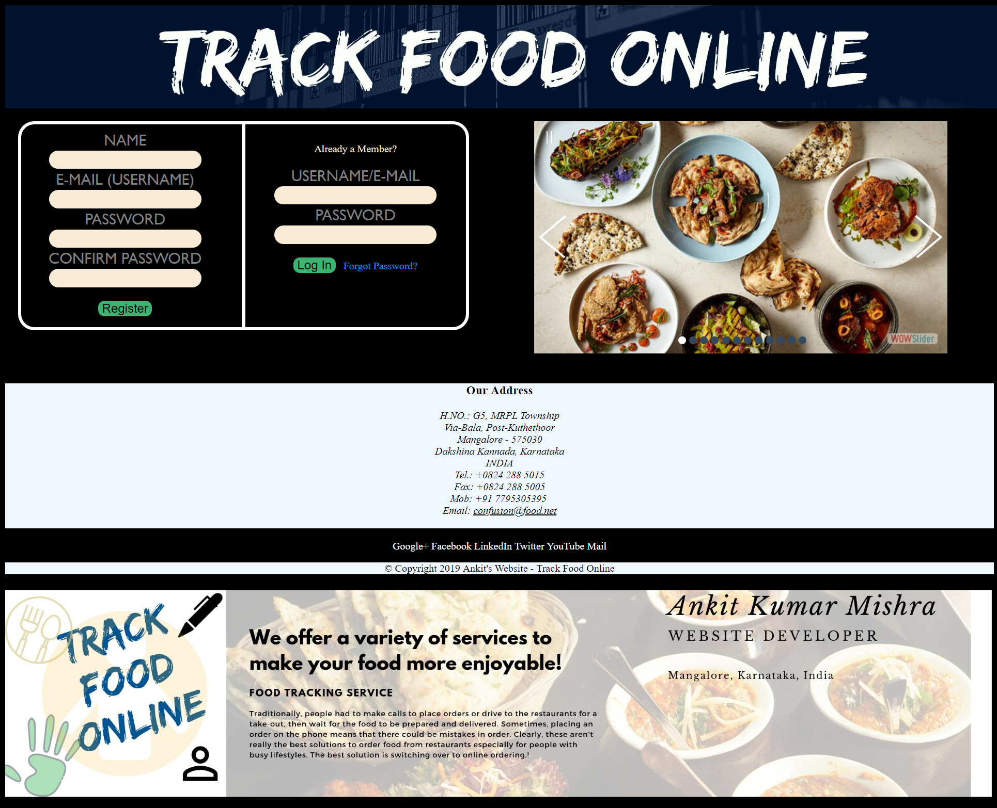

Slide 3
Why to order online?
Easy process
Less time consuming
Why will the store owners opt?
Order Management
Marketing
Customer Data

Slide 4
Technologies used:
Hypertext Markup Language(HTML)
Cascading Style Sheets (CSS)
JavaScript
Jquery
AngularJS
Bootstrap

Slide 5
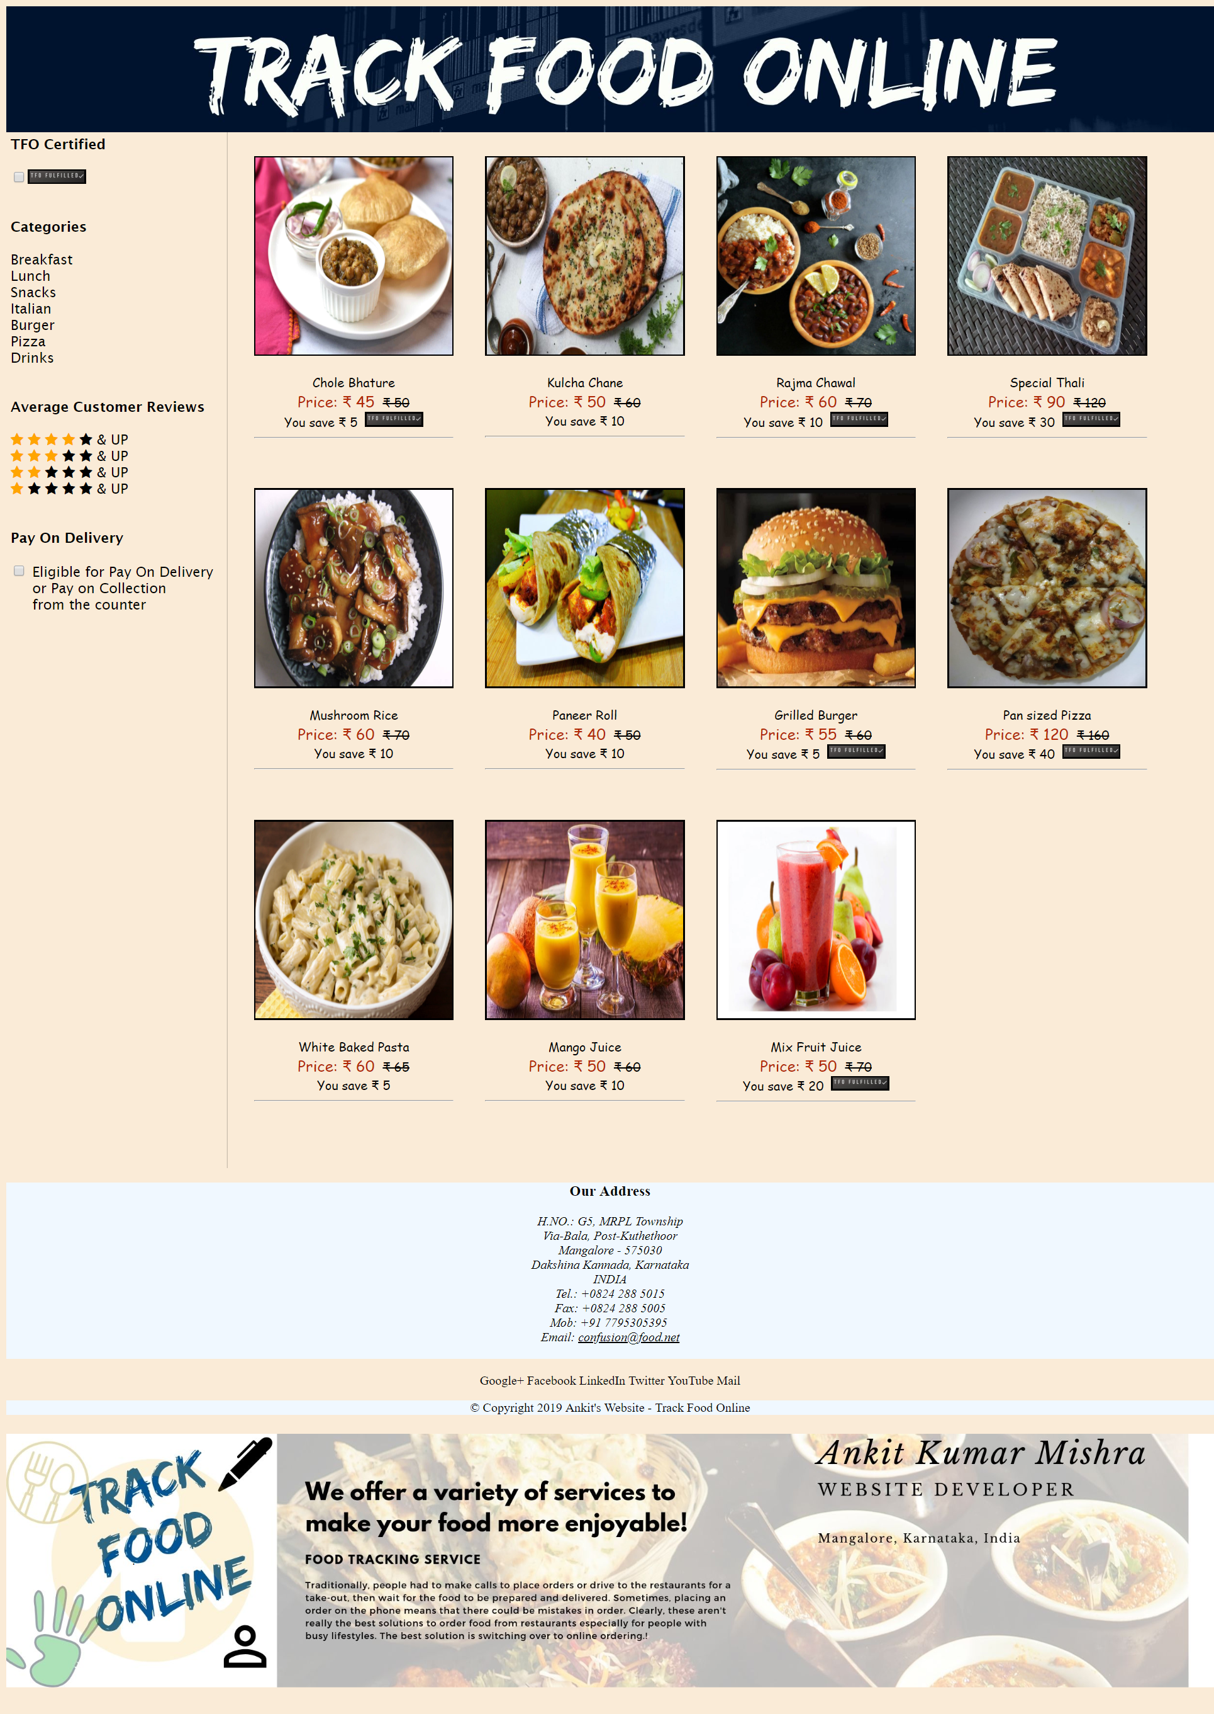
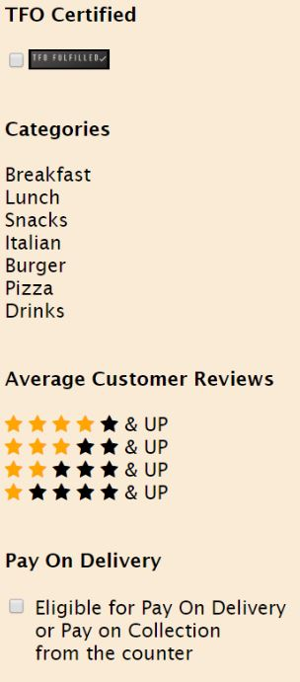

Slide 6
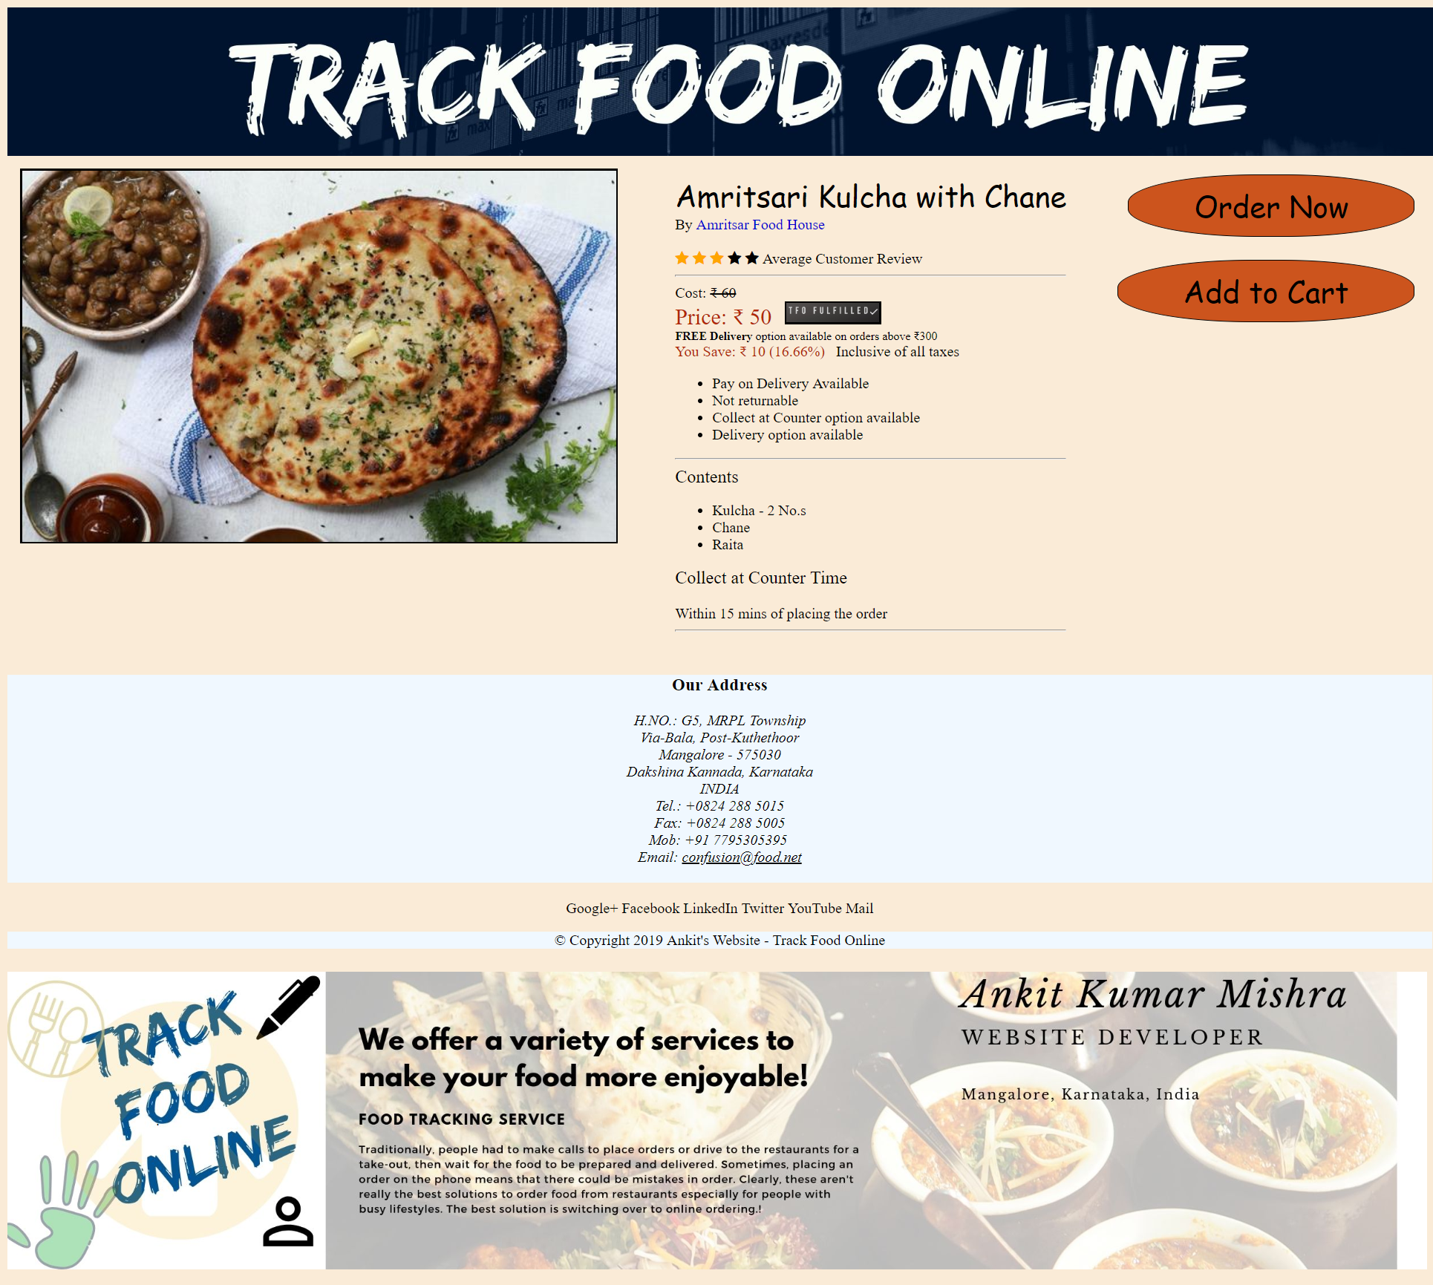
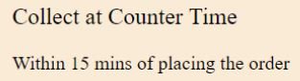

Slide 7
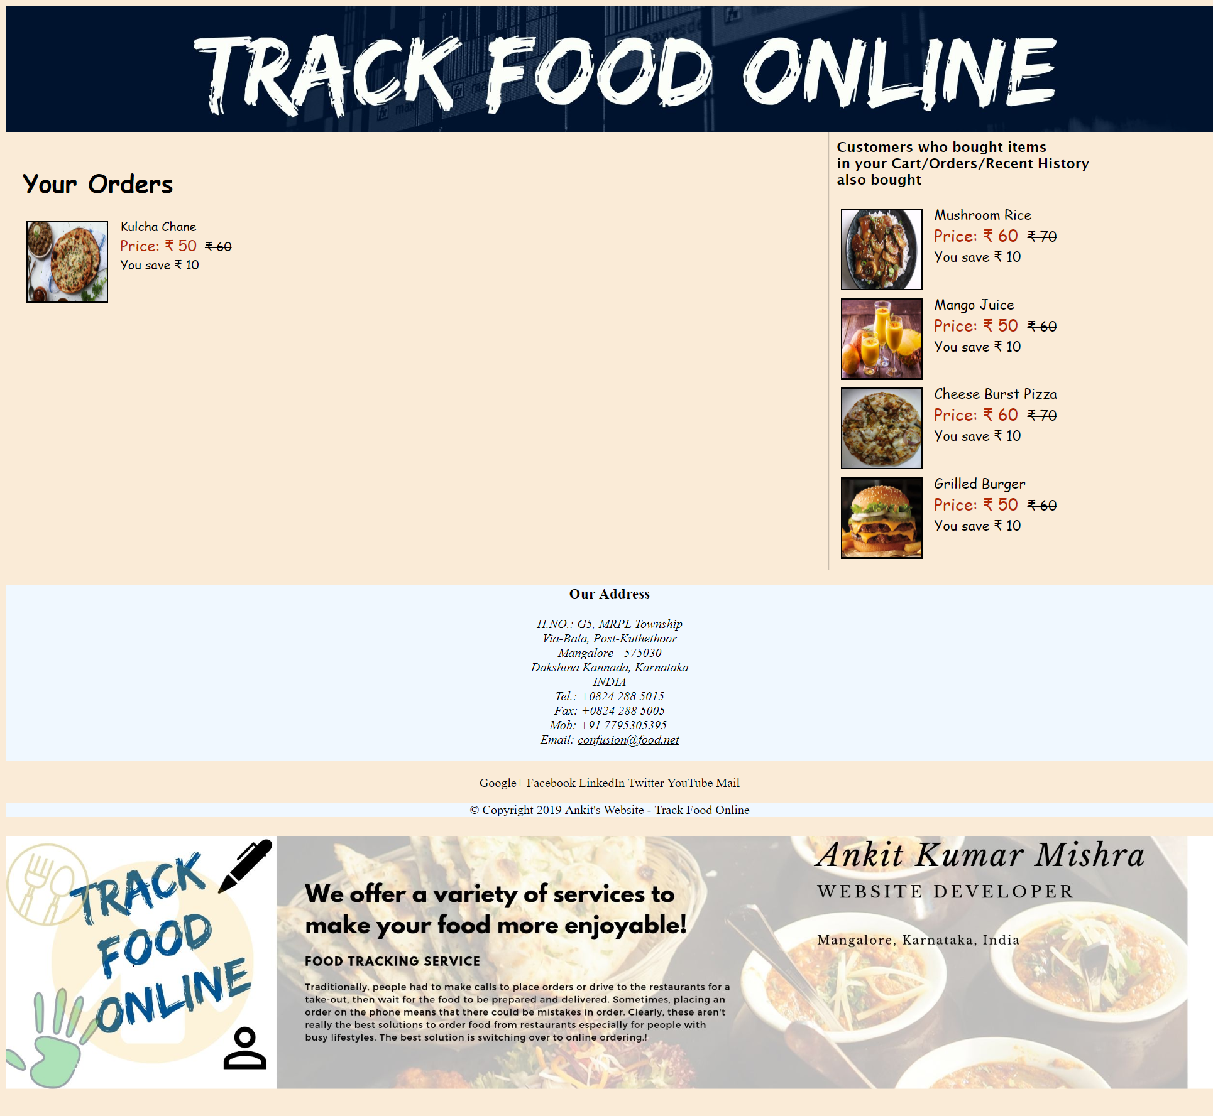
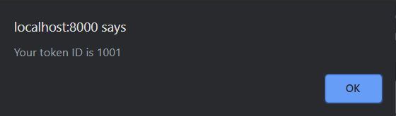

Slide 8
End of the presentation
Thank you

